Slide 1
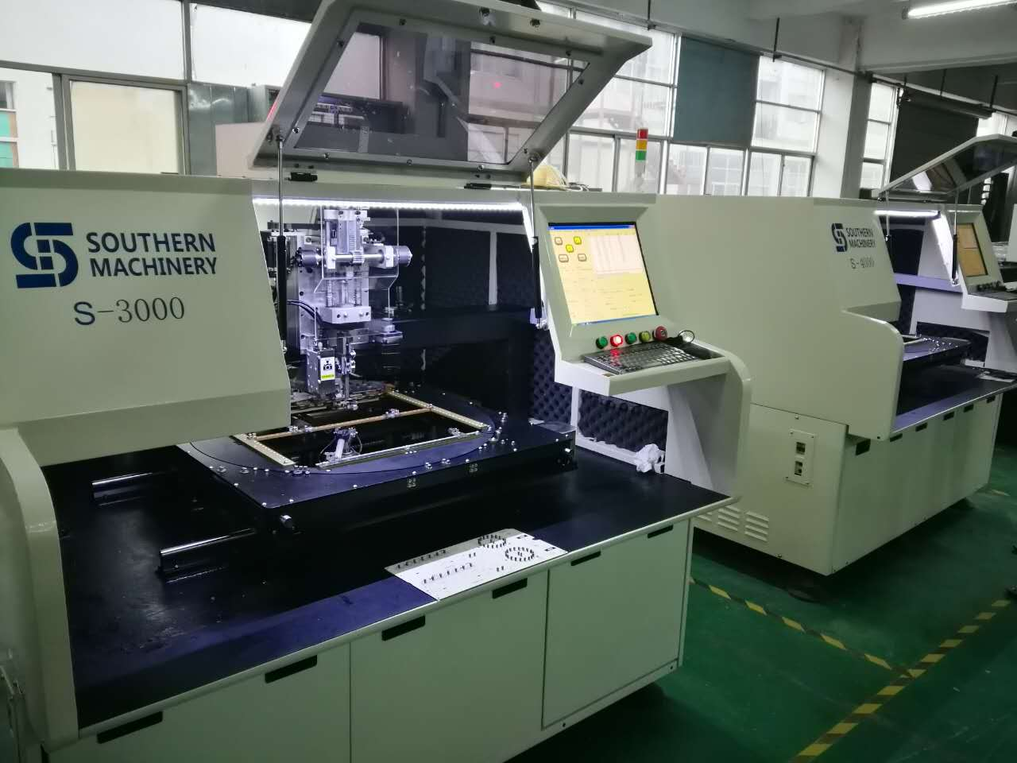
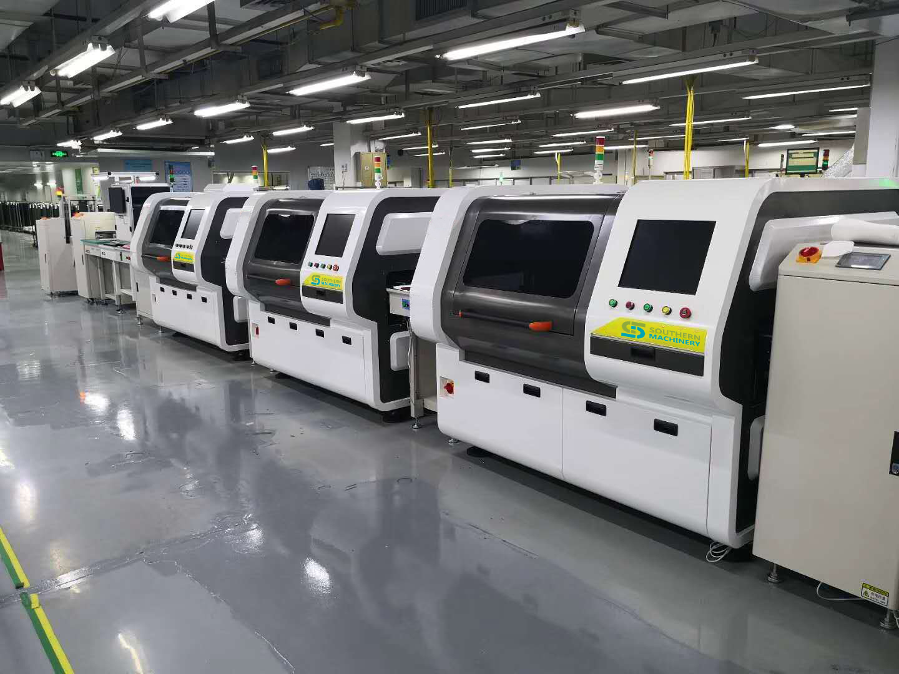
Low cost Auto Insertion Solutions
Professional THT
Worldwide support
Free Installation and Training
Free THT design guidance

Slide 2
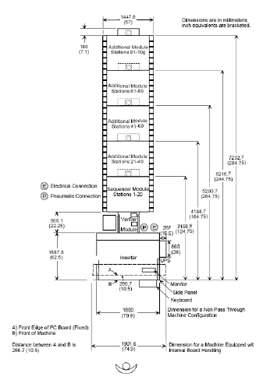
S-3000 Radial Insertion Machine
Up to 22,000 cph
Off-line/In-line operation availability
Using imported precision ball-screw & AC Servo
system, positioning accuracy <0.001mm
Vision system for positioning and insertion alignment
Accurate insertion angle in 0-360º,with 1ºincrement
Integral forming cast iron machine frame
Multiple lead span combination available：2.5/5.0mm; 2.5/5.0/7.5mm; 5.0/7.5/10.0mm; 2.5/3.5/5.0mm; 2.5/5.0/7.5/10.0mm
Option of automatic error recovery
Long lifetime insertion driving axis structure
Compatible with Universal insertion m/c feeder
USB port for data transfer & Excel format compatible

Slide 3
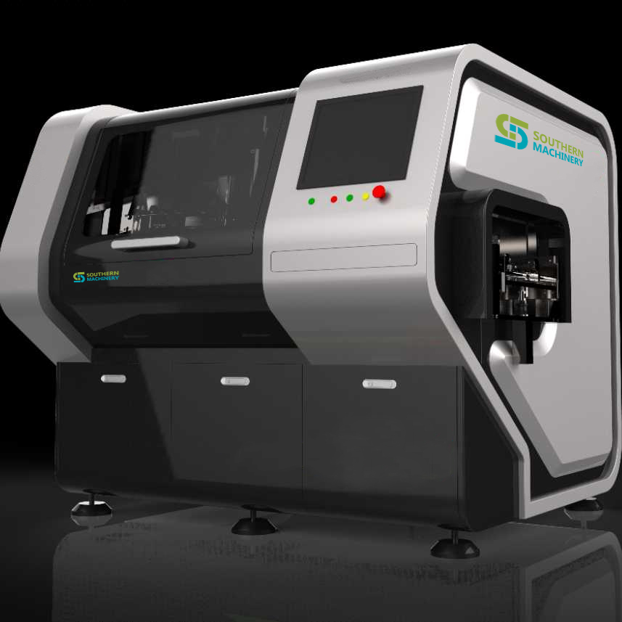
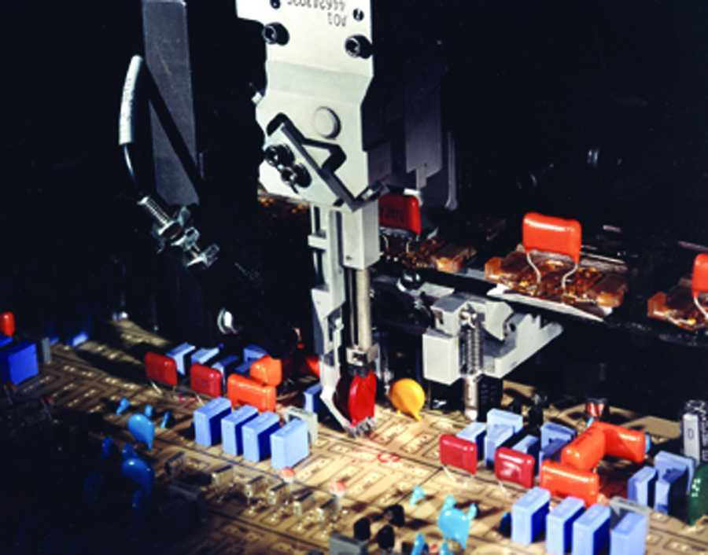
S-3010
Off Line/in line
High speed
Radial insertion m/c
10 feeders only

Slide 4
Machine Outline & Size
Dimension L1750 x W1450 x H1700mm(Off-Line)
Dimension L1920 x W1450 x H1700(In-Line)
Weight: 1150kg
Feeder Module L1800 x W1450 x H1100mm

Slide 5
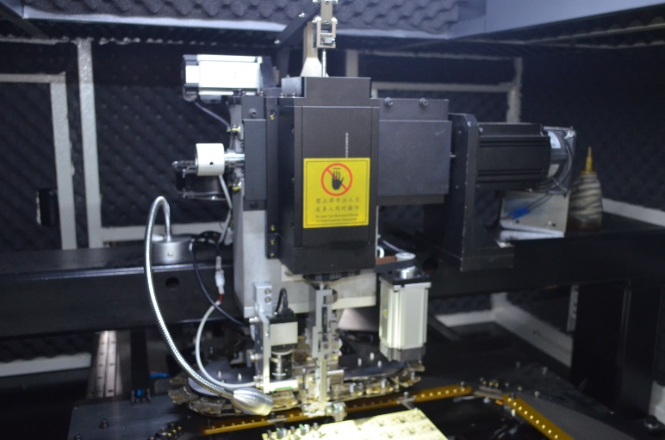
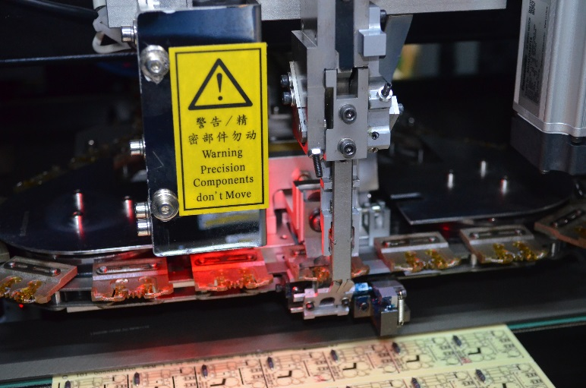
Insertion HEAD
Toothed bar driving axis，reduce cost and easy alignment
2000W motor driving,higher insertion speed
Accurate insertion angle in 0-360º,with 1ºincrement
Cover 4 different lead span 2.5/5.0/7.5/10.0mm
Insertion depth programmable
Servo driven component transfer to main claw structure(CTA)

Slide 6
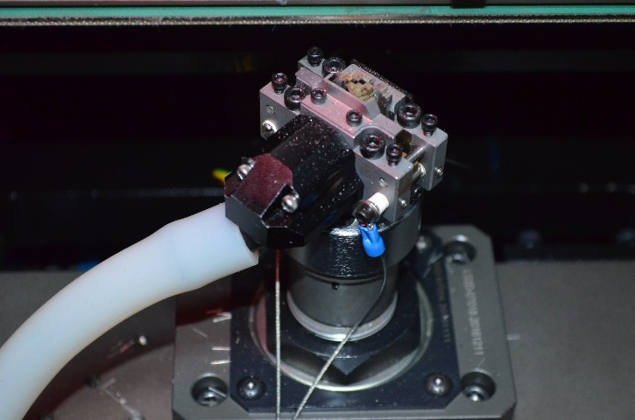
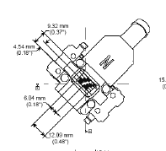
Cut & clinch HEAD
1.2/1.5/1.8mm lead length selectable, 10-35ºclinch
3.5mm lead span components
Inward/outward clinch
Servo driven cut & clinch module up/down
Lead scrap collection mechanism

Slide 7
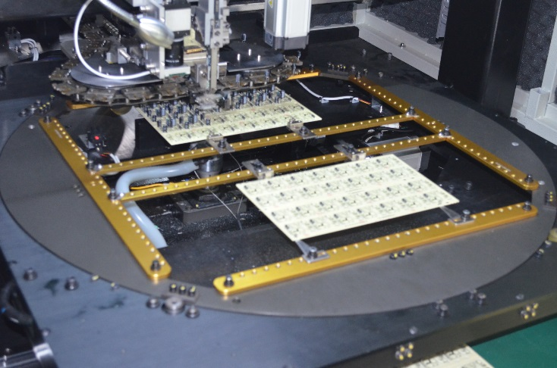
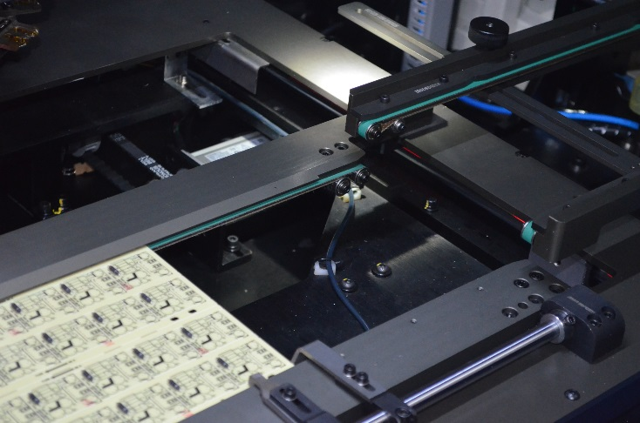
Work board holder or
Board handling System
360º clockwise/counter clockwise rotation table (Off-line m/c)
PCB size Min: 50x50mm ; Max: 450x450mm
Non-stop PCB loading
WBH
Auto PCB load/unload, width adjustable conveyor(On-line m/c)
PCB size Min: 50x50mm ; Max: 400x285mm
SMEMA interface
BHS

Slide 8
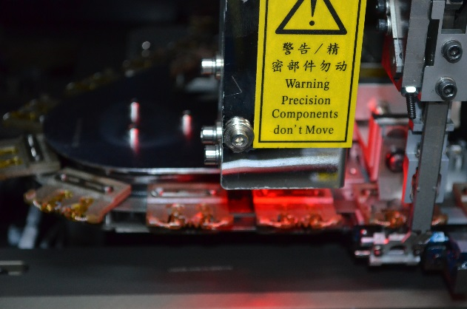
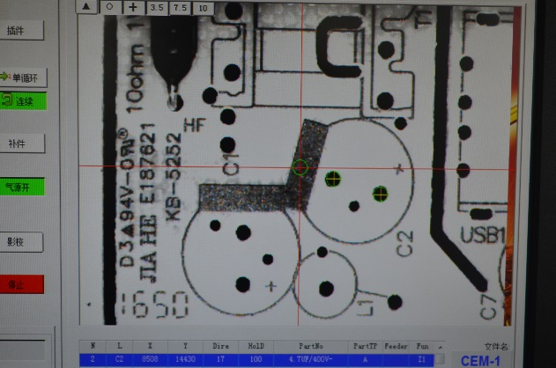
vision Position correction
0.3 mega pixel, 256 grey scale industrial camera for vision system
Fiducial mark recognition for positioning and alignment
Vision automatic align insertion position
Position deviation less than 0.001mm

Slide 9
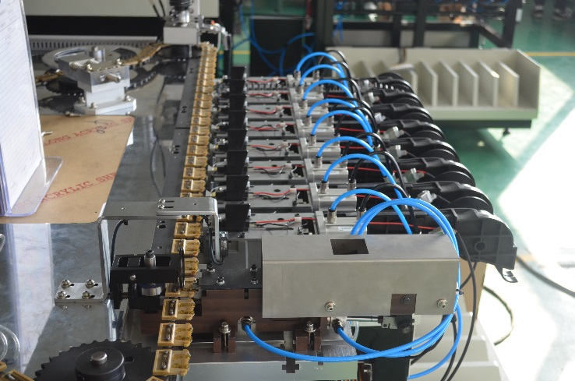
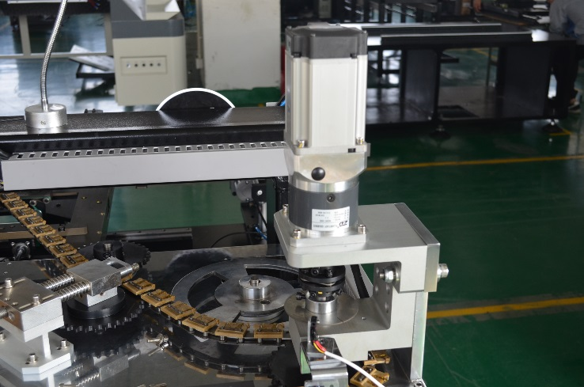
SEQUENCER chain
750W Panasonic servo motor, high speed & stable
Strengthened chain tension adjustment, convenient for adjustment
107 pcs longer lifetime component carrier clips(Consumable parts)

Slide 10
SEQUENCER chain
Servo motor, high speed & stable
Strengthened chain tension adjustment, convenient for adjustment
longer lifetime component carrier clips(Consumable parts)

Slide 11
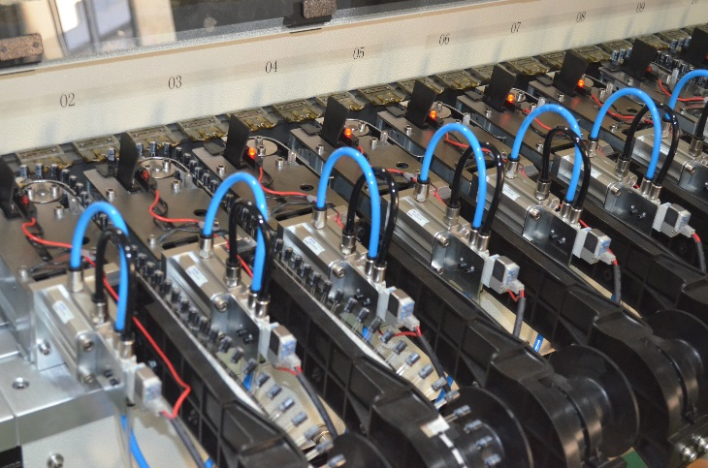
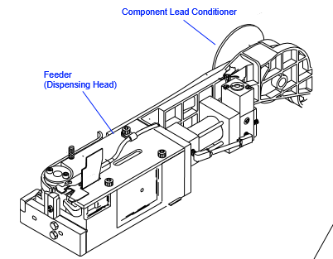
Radial Lead Component Feeder
10/20/30/40/60/80 Component stations
Compatible with Universal insertion m/c feeder
New designed,reduce component jam possibility
Fast changeover ， convenient for maintenance
Feeder add-on retrofit availability after ex-factory

Slide 12
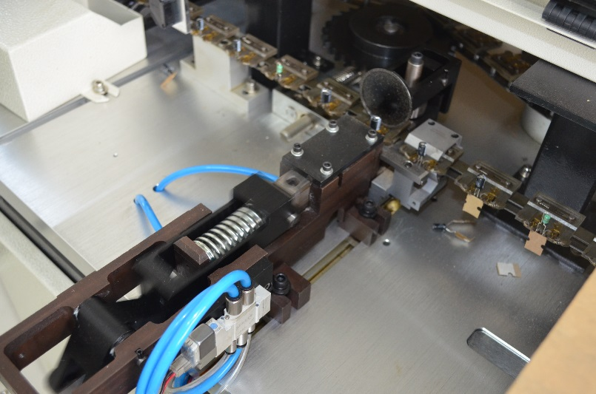
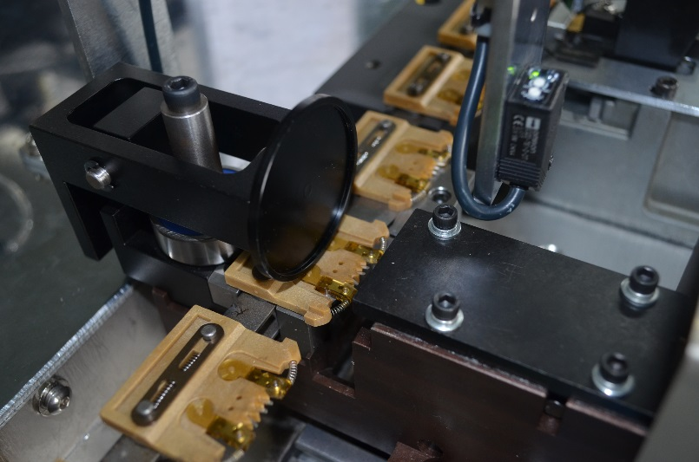
Tape cutter station
New designed to guaranteed lead cutting verticality & long lifetime
Improving tape clamp & remove structure
Convenient for alignment & maintenance

Slide 13
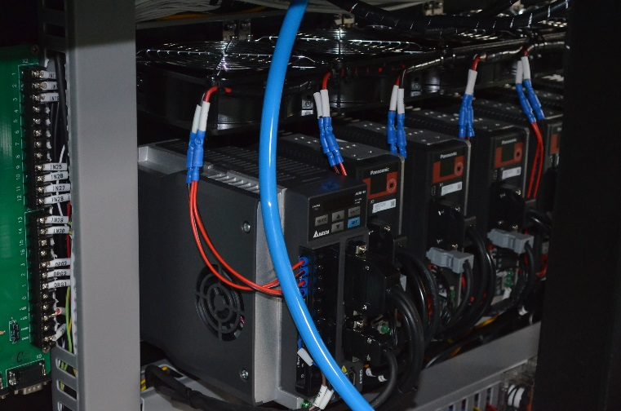
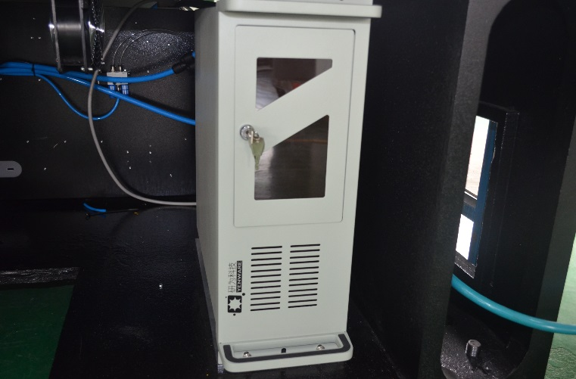
Electronic controller
Japan servo driving system
Windows 7 system
Industrial computer control with Chinese/English
interface
Option of remote control availability

Slide 14
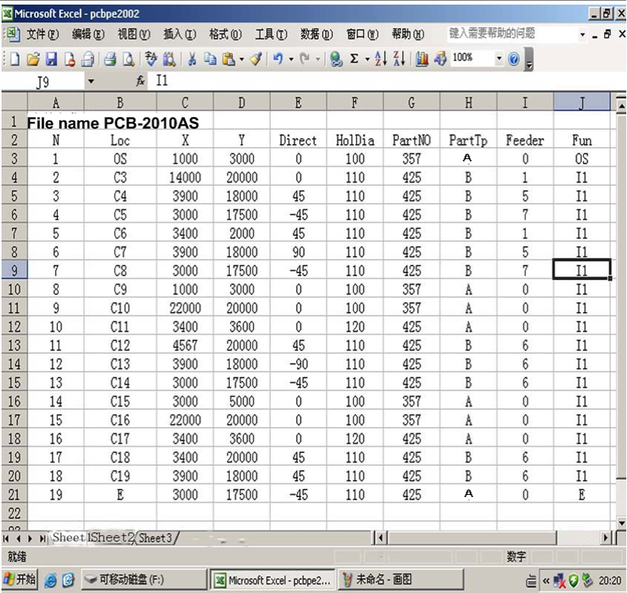
programming
USB port for data transfer, Gerber format (Excel)file input, program automatically created
Vision on line teaching position, automatically align position

Slide 15
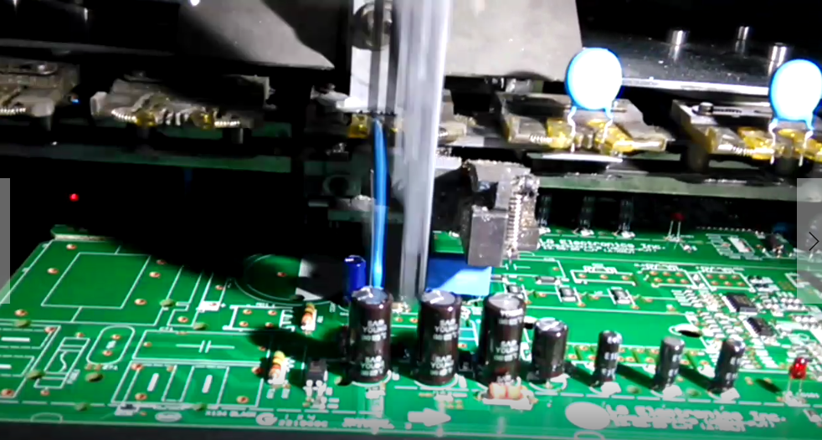
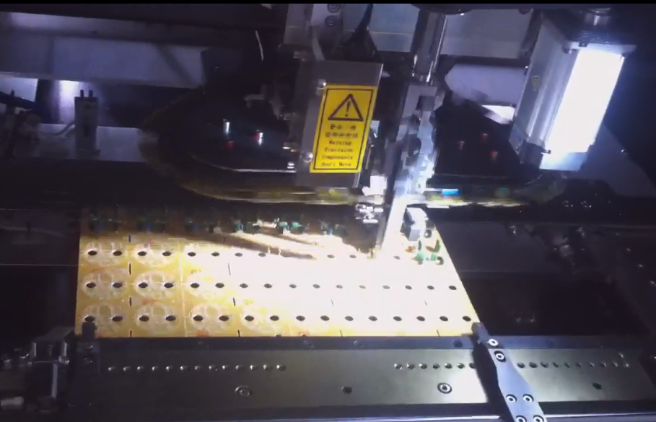
Service Requirements
Power requirement:AC220V, 50/60Hz, 1.5Kw
Maximum Neutral to Earth Ground voltage is limited to 5VAC.
Compressed air requirement 0.6 Mpa 0.3m³/min
Non-lubricated, dry air, dew point must be at 11°C (51°F) below ambient temperature

Slide 16
Machine Working Video
— List Price $70K
— Worldwide Support
— Free Installation/ Training
— Auto PCB loading
— 6 Months ROI
More Radial machine video, Please Youtube: Auto Insertion

Slide 17
Welcome inquiry
1,Please visit : www.smthelp.com
2, Find us more: https://www.facebook.com/autoinsertion
3, Know more our team: https://cn.linkedin.com/in/smtsupplier
4, Welcome to our factory in Shenzhen China
5, Look at more machine running video:https://www.youtube.com/jasonwuSMT
4, See more in Google: Auto+Insertion

